Slide 1



Intra-ACP Climate Services and Related Applications
Programme

Slide 2









INTRA-ACP CLIMATE SERVICES AND RELATED APPLICATIONS PROGRAMME
www.climsa.org

Slide 3
OUTLINE OF
CONTENT
01
Introduction
  Edit text
  Edit text
04
02
05
03
06

Slide 4

01
Introduction

Slide 5
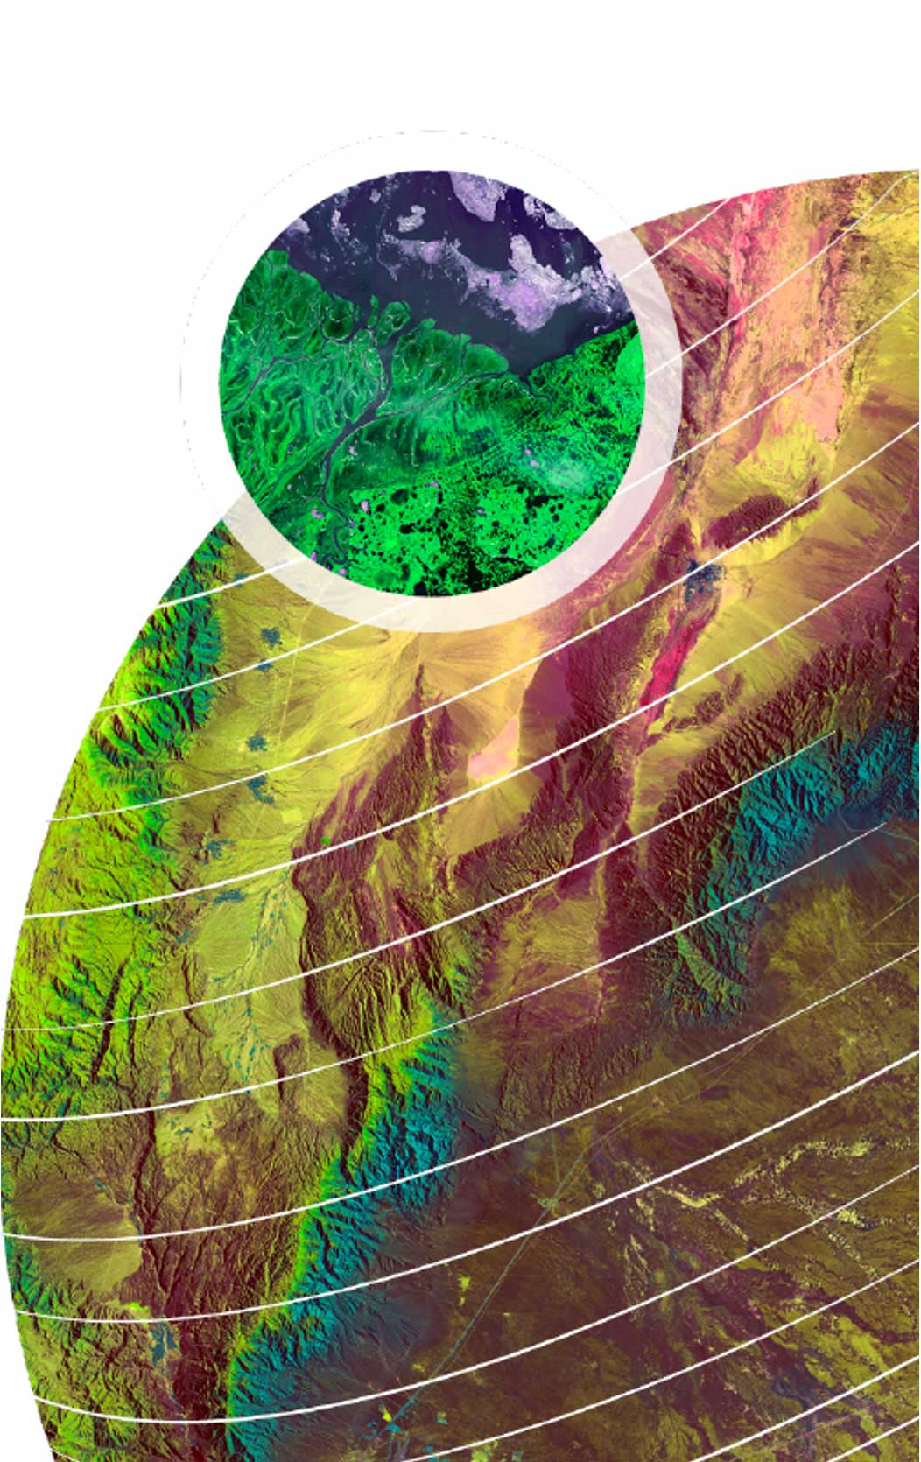
01
Introduction

Slide 6
01
1.1. Text edit

Slide 7
01
1.1. Text edit

Slide 8

02

Slide 9
02
Edit text
  Edit Text
Edit text
  Edit Text

Slide 10
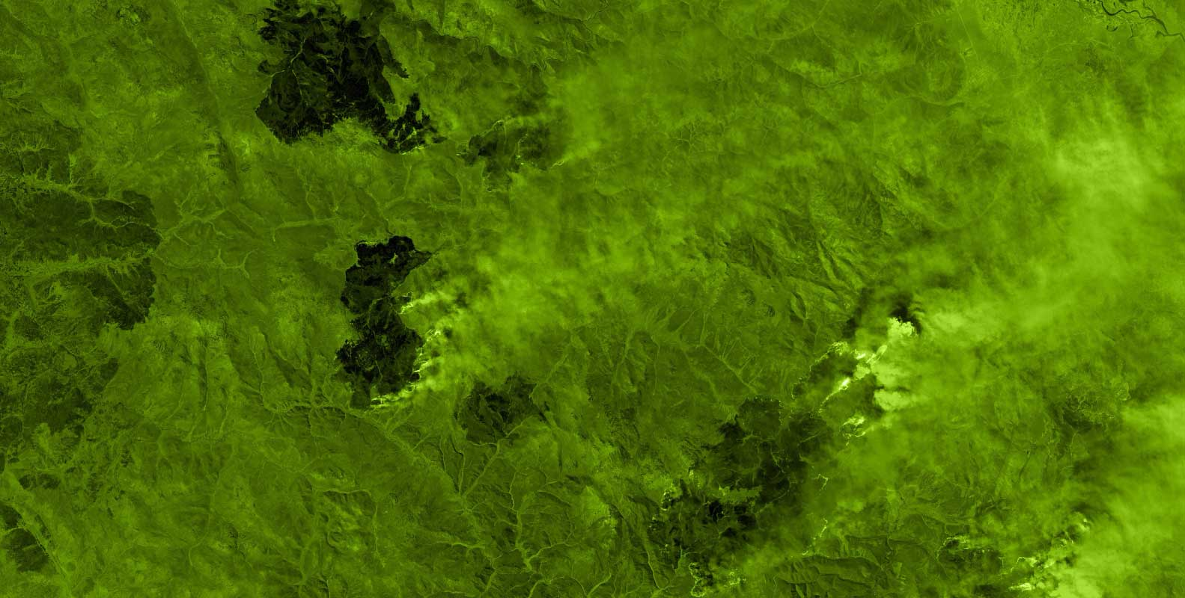
03

Slide 11
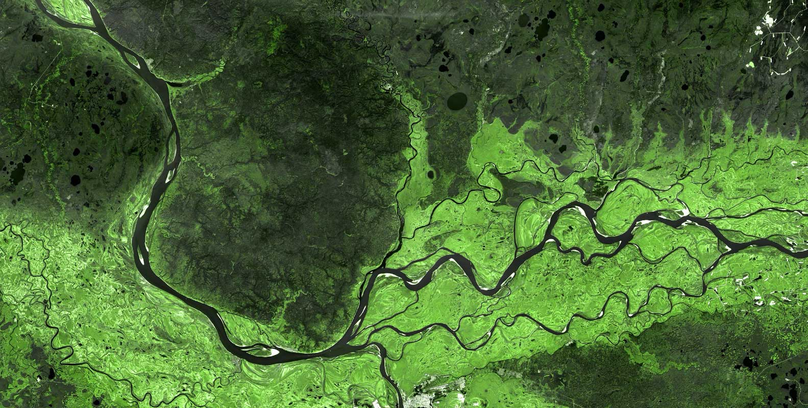
04

Slide 12

05

Slide 13

06

Slide 14

Intra-ACP Climate Services and Related Applications
Programme

